Slide 1

Data Mining/Machine Learning
Personalized Tourism Itinerary Recommender System
Guide: Dr. B Narsing Rao
Team:
Chiranth Gopal K 1PI13CS047
Gourish Hebbar 1PI13CS062

Slide 2
Data Mining/Machine Learning
Problem Statement
To provide personalized itinerary for attractions based on user location and preferences

Slide 3
Data Mining/Machine Learning
Solution
To build a web app using a recommendation engine which generates a path of places to be visited in particular order

Slide 4
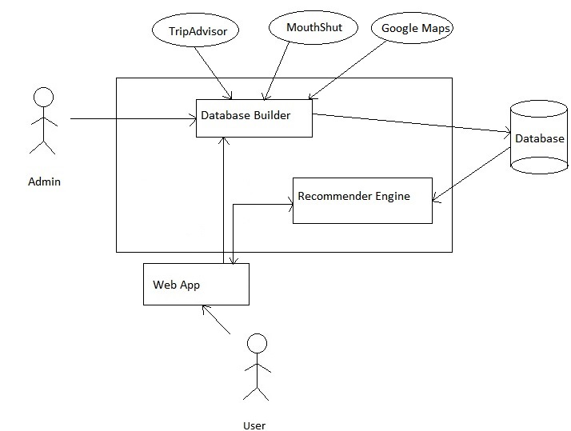
Data Mining/Machine Learning
High Level Architecture

Slide 5
Data Mining/Machine Learning
Brief Overview
Show user recommended places with ratings and suggested time to be spent on the place on a map
Also show other recommendations as a list of places
User can
Modify the time they would want to spend at a place
Add/remove a place from their itinerary using the recommended places list
For stay of multiple days, places visited on the previous days will be excluded from further recommendations

Slide 6
Data Mining/Machine Learning
User inputs
Duration of stay
Start time for the day
End time for the day
Start/end point of the trip
Preferences of place

Slide 7
Progress Till Date
We have scraped data for places around Mysore and have stored it in MySQL
Columns of data we currently have are
Place name
Categories
Latitude
Longitude
URL for more details
Average time spent per visit (Manual input)

Slide 8
Progress Till Date
We have created basic front end, in which user can select categories of places and can choose his location on the map by dropping a marker
Based on the categories the user selects, an AJAX call goes to the backend.
We have created a basic PHP backend file, which takes this request, opens a connection to the database, and fetches the data through a query and returns it to the front end
In the front end, we then display the places on a map, and give a table with all the places and the details mentioned

